Slide 1
Predictive Modeling – CNN Practice by Group 7
Jiansong Chen
Chenghao Yu
Sen Fu
Hongru Liu

Slide 2
Network From Scratch
Data Set Construction
Data Pre-Processing
Model Framework Design
Loss Function Design
Linear Filter
Save model and show prediction

Slide 3
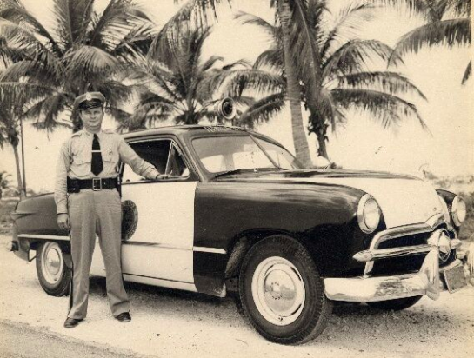

Data Set Construction

Slide 4
Image Processing
Rescale
150*150
1
Reshape
200 * (150,150,3)
to 3 * (200,150,150,1)
2

Slide 5
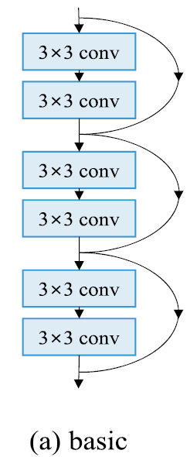
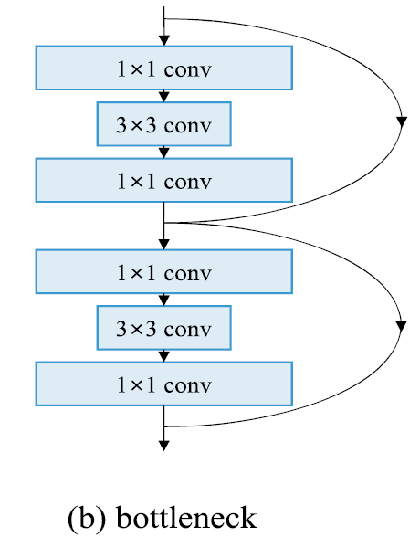
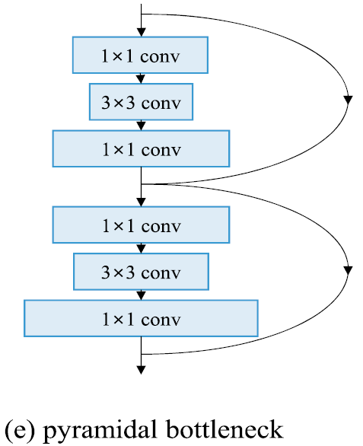
Spread of the blue bar:
Number of filters of a certain layer
Numbers in the blue bar:
Convolution Kernel Size

Slide 6
Bottleneck Network Frame
Medium ability of feature extraction
Used for general image Super Resolution
Converge fast
Downside:
Relatively Slow
Heavy RAM Consumption

Slide 7
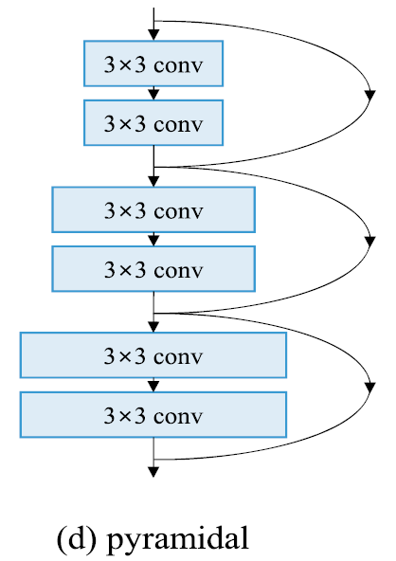
Pyramidal Network Frame
Relatively Fast
Gradually increase the number of features extracted instead of drastically.
Network is harder to be jeopardized by local abnormal values
So far mostly used for classification

Slide 8
For Image Super Resolution
The data input is relatively homogenous (Less risk of overfitting)
Speed is essential
Model Training converging speed
Training speed
Prediction speed

Slide 9
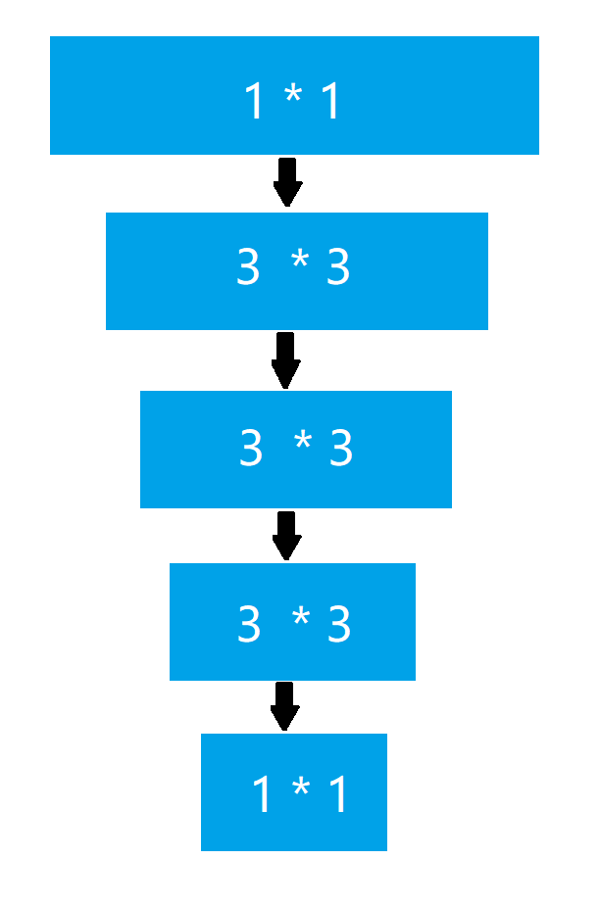
Hour-Glass Network Frame

Slide 10
Loss Function
Hour Glass Model is the model that makes advantage of the fast-converging nature of the bottle-neck Convolutional Neuron Network and the feature contraction design. This network will maximize the info preserved from the original picture. At the same time, it can be trained fast.
Depends on hidden layer #
Hour-Glass Network Frame

Slide 11
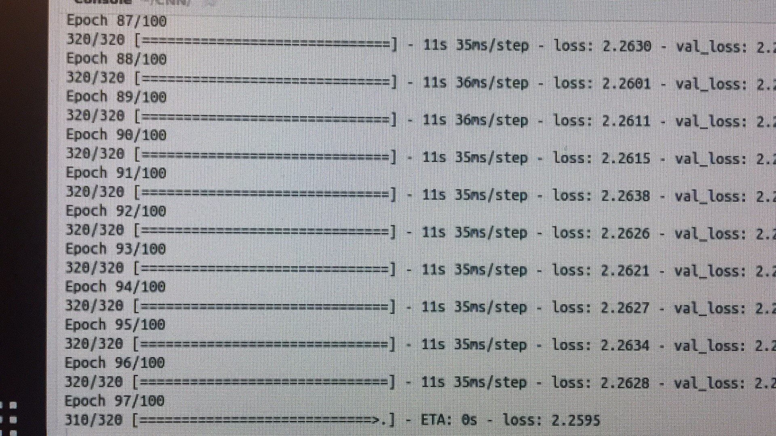
Loss Function
Hour-Glass Network Frame

Slide 12
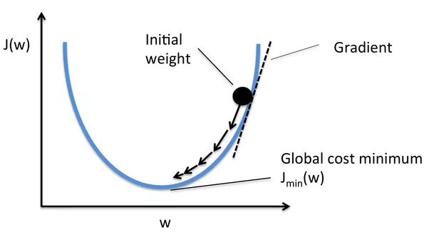
Loss Function Design

Slide 13
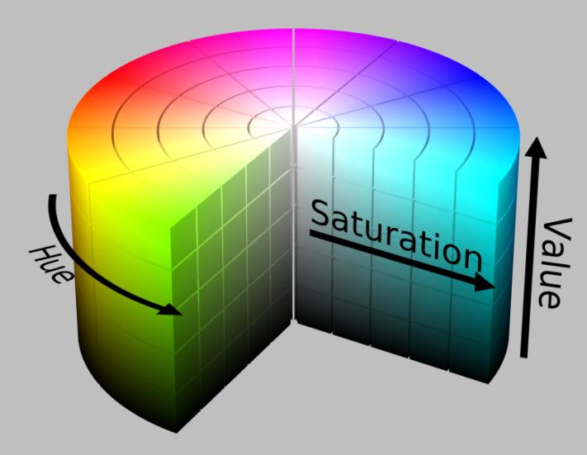
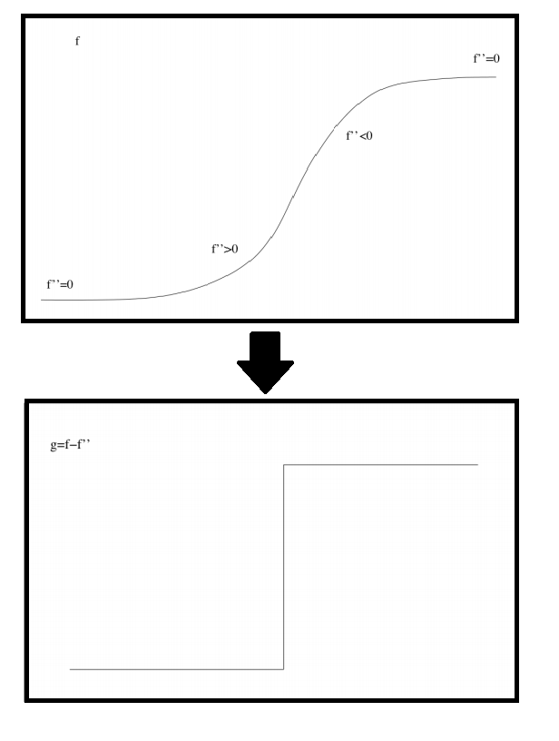
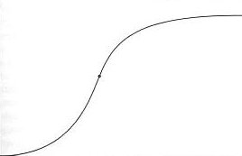
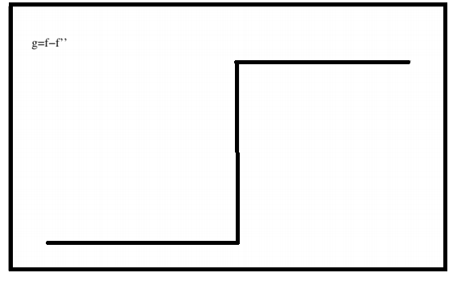
Linear Filter
Saturation Filter
Image Sharpness Filter
Intensity Adjustable
Compensate the Blurry Effect of MSE
Unbiased Enhancement

Slide 14
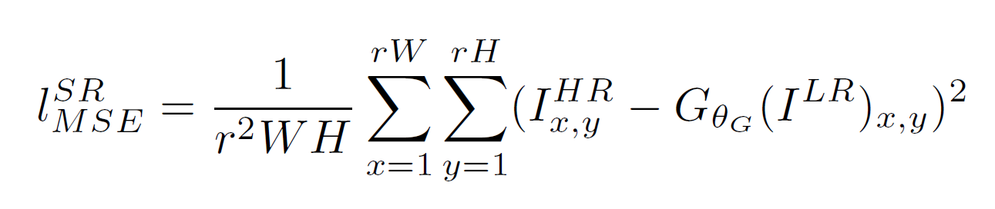
Loss Function
Common Loss Function:
Mean Squared Error
Simple to use
Represent single pixel lost
Not making assumptions
Downside:
Easy to be effected by extreme values
Fitted values tend to approach to the algorithmic average
MSE Loss Formula:

Slide 15
RESULT: Baseline vs. Improvement
PSNR: 21.692
Run Time (measured in per Pic):
6.5 seconds/picture
Baseline
PSNR: 23.499
Run Time (measured in per Pic):
5.2 seconds/picture
Improve

Slide 16
Future Plan
Linear Filter
Loss Function
Cross Validation

Slide 17
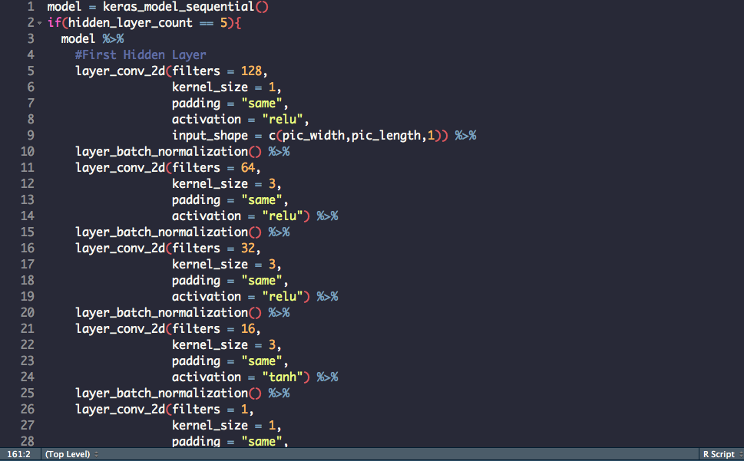
CNN Model

